Slide 1
Crowdsourcing: Light-weight Application For Disaster Management
A presentation conducted on course research material
Group Members:
Awwab Hamdatu
Al Hussain M Al Dawood
Abdullah M Alkaabi
Nahidh A Alhijji
Elias A Aldubais

Slide 2
TABLE OF CONTENTS
01
02
03
04
INTRODUCING MOTIVES AND IDEA
CROWDSOURCING AND PAST RESEARCH
Overview, inspiration, our goal, the main idea.
Leveraging Crowdsourcing, discussing ideas suggested by past research.
OUR CONTRIBUTIONS AND EXPERT OPINION
REFERENCES AND CONCLUSION
Our Biggest Contributions, Escape route algorithm, Social Media Data Extraction, and WIFI-less support.
Research References, and conclusion.

Slide 3
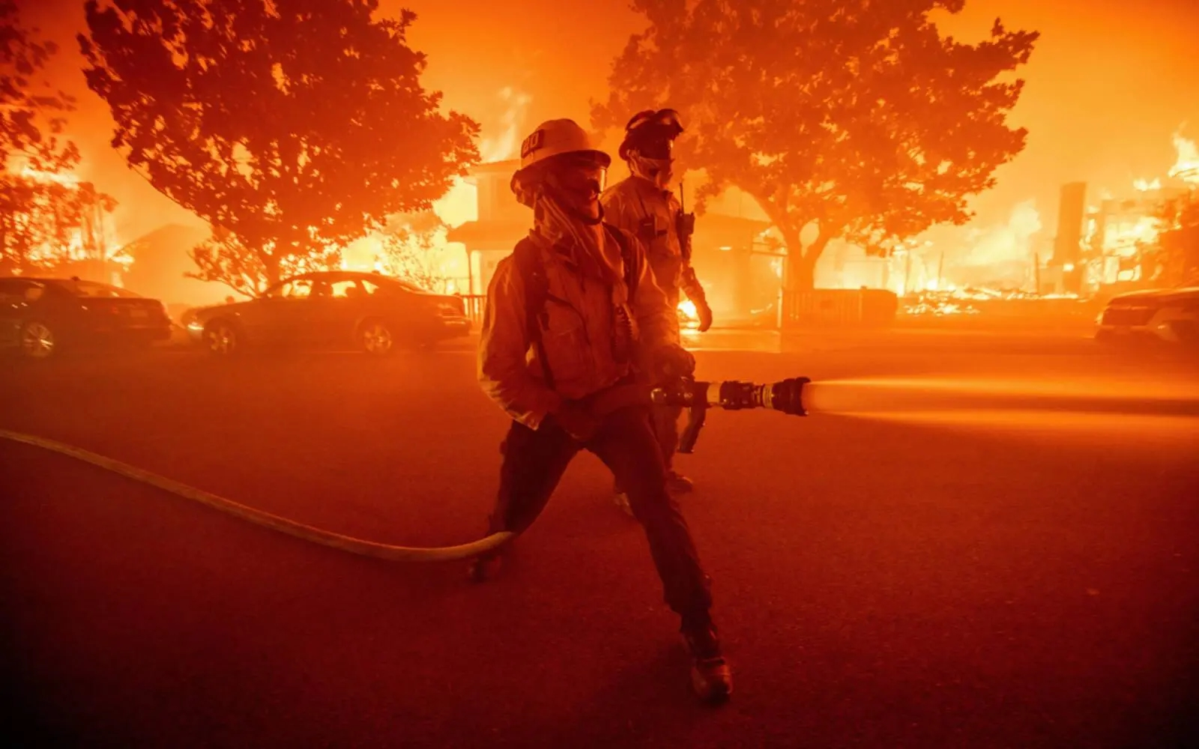
01
INTRODUCTION
Our Inspiration: Recent LA Fires
Our Problem Statement: Lack of Effective Disaster Management.
Our Goal: Safety of The People.
Notes:
The inspiration of our idea came from the recent LA fires where on January, the traditional 911 system was overloaded due to a large number of distress calls, leaving callers waiting for help, with no clear idea of what to do. Emergency responders were stretched thin, and many people got injured due to these delays.
We noticed how these delays made a deadly situation even worse, and realized that a better and more flexible system was necessary.
Our Problem Statement concerns the fact that most current emergency systems rely on centralized reports, which can get overwhelmed very fast. Additionally, when no help is available, most people simply wouldn’t know what to do next in a deadly situation. This is what has mainly inspired us to come up with this app.
Our goal is the safety of the people. We aim to develop an app that saves as much lives as possible during deadly situations, including situations where help from higher authorities is not possible or guaranteed. Dealing with the disaster itself, such as extinguishing the fires, will be left for higher authorities. This is beyond the scope of this application.

Slide 4

02 CROWDSOURCING AND PAST LITERATURE
Introduction to the concept of Crowdsourcing.
How Past Literature Has Leveraged Crowdsourcing for Disaster Management.
Crowdsourcing and Disaster Management are not strangers to one another.
How crowdsourcing can be used for Disaster Management.
Issues with Past Suggestions.
No Clear Mentioning of Data Collection Method.
Many Ethical Issues Concerning Misinformation.
No Clear Volunteer Motivation Technique.
Outdates Techniques.
Notes:
Introduction to the concept of Crowdsourcing:
Crowdsourcing is the process of tapping into the collective knowledge, skills, and resources of a large group of people—often the public—to solve problems faster and more efficiently. Instead of relying on a single authority, it distributes tasks across many individuals, turning everyday observers into valuable contributors. Think of it like a digital neighborhood watch: when everyone shares what they see, the bigger picture becomes clearer.
How Past Literature Has Leveraged Crowdsourcing for Disaster Management: Disaster response and crowdsourcing are no strangers. Past research has shown how everyday people can become first responders with their smartphones.
The model is simple but powerful: someone spots a hazard (e.g., a flooded road), reports it via an app, and others nearby—or authorities—get instant alerts to avoid the area. This turns victims into active responders, filling gaps when traditional systems are overwhelmed. No Clear Mentioning of Data Collection Method:
Past Research has always suggested the collection of data from volunteers, as this is the literal essence of crowdsourcing. However, most publications do not explicitly mention a reliable and efficient way of actually collecting this data from the volunteers.
Many Ethical Issues Concerning Misinformation:
As most publications do acknowledge that misinformation can be a big problem, but they don’t really address it, and at most instances just request for further research regarding that problem.
No Clear Volunteer Motivation Techniques:
This is easily the biggest problem when it comes to Crowdsourcing. If people are not willing to volunteer in the first place, then there is no data to use, if there is no data to use, then obviously the app cannot do anything.
Outdated Techniques:
There Actually hasn’t been a good quality paper on crowdsourcing for disaster management in a while. Most mentioned technologies in past research already have higher quality alternatives.
In our research, we address each of these problems, provide our own unique solutions, and demonstrate alternative techniques that could be used when problems are faced.

Slide 5
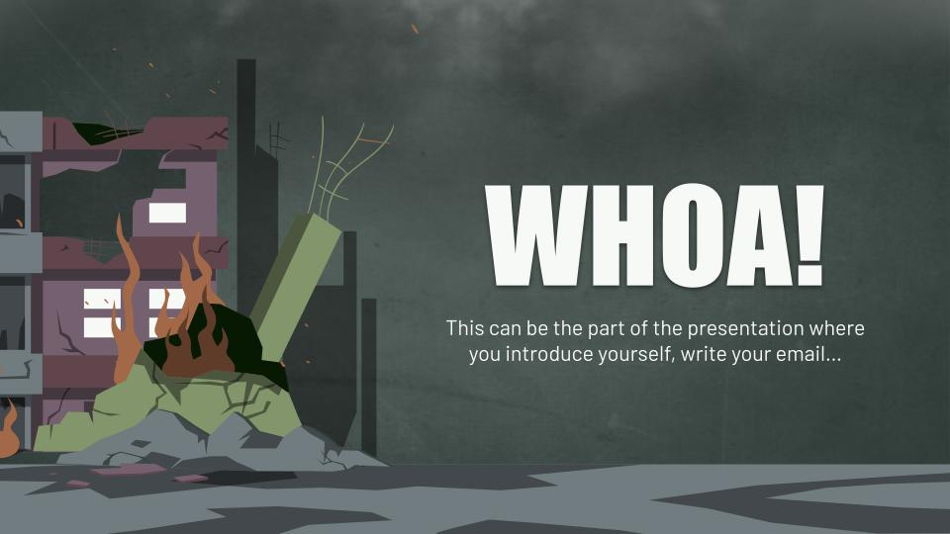
02 Crowdsourced Data Collection and Processing
Primary Data Collection Method:
Image-Based Data Submission.
Combating Mis-information: App-Independent photo-Taking.
Image Metadata Extraction.
Volunteer Hazard Verification.
Volunteer Trust Score System.
Secondary Data Collection Method:
Swift Button-Based Reporting (Useful when disaster is confirmed).
Notes:
Image-Based Data Submission:
This is the main way in which we will collect data from the volunteers. Someone spots any sort of incident, they take a picture of it, and submit it through the app.
Combating Mis-information: App-Independent photo-Taking:
The submitted images must be taken directly through the app. The app will have its own integrated camera system, and the user must directly use it to submit an image to report an incident. This restricts users from uploading any sorts of old photos, stock images, AI-generated images, which immediately eliminates around 80% of fake reports. If you’re not there, then you simply can’t report it.
Image Metadata Extraction:
Every time you take a photo, there is additional data attached to that image, such as when it was taken, where it was taken, and which device took it. This is called Metadata, and it is how your phone is actually able to organize your images by location. So, when you take a photo through the app, this metadata will be extracted and fed to the app. Not only will it be useful to tell whether a report is fake or not, but the location attached to that image could also be used to flag later on.
Volunteer Hazard Verification:
Initially, when someone uploads a report, only very nearby people will be notified, and will be asked to confirm whether this hazard is actually real or not. As more people verify that report, the trust score of the report continues increasing.
Volunteer Trust Score System:
Every Volunteer may have a trust rating attached to them, like a percentage. When a report is made, its authenticity is calculated based on the amount of nearby people confirming that report, and the trust ratings of the volunteers confirming them. If your trust score becomes very low, you may be restricted from uploading reports, or the weightage of your reports may be very low.
Swift Button-Based Reporting:
"When sirens are blaring, nobody has time for photos. A single button-press shares your location and flags that area – because sometimes fast beats perfect."

Slide 6
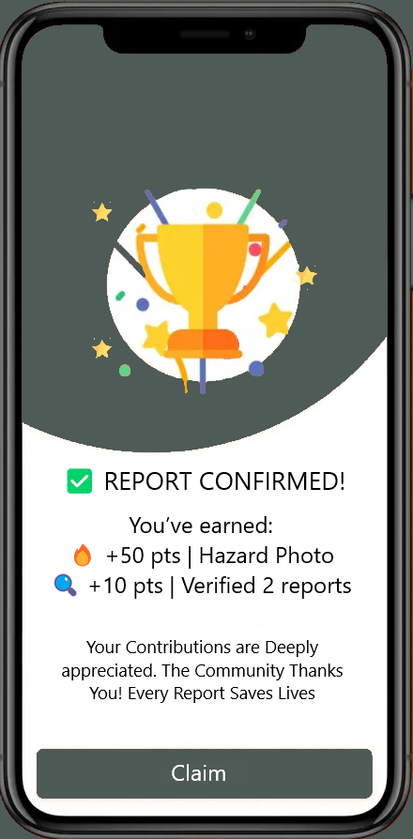
02 Challenge: Motivating Crowd Volunteering
Gamification Element
Points System
Redeemable Points
Badges showcasing Contribution
Notes:
An approach we aim to take to motivate crowd volunteering involves a type of “Gamification Element” involving a points system. You earn these points after you have contributed to a recent disaster. Things such as submitting your own reports, confirming other people’s reports as real or fake reports, are all actions that could earn you some points. You can then redeem these points for real value such as gift cards. Additionally, as we know, the importance of school service hours is increasing, and a certification or badge showcasing your contributions during a disaster can play a huge role. Many US Universities also care a lot about your volunteer hours.

Slide 7
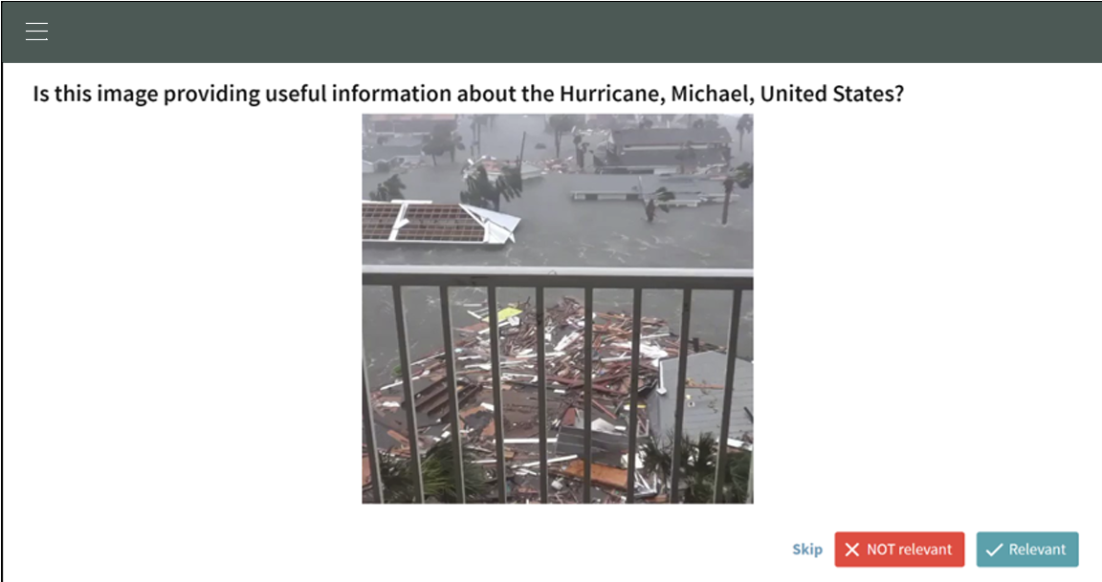
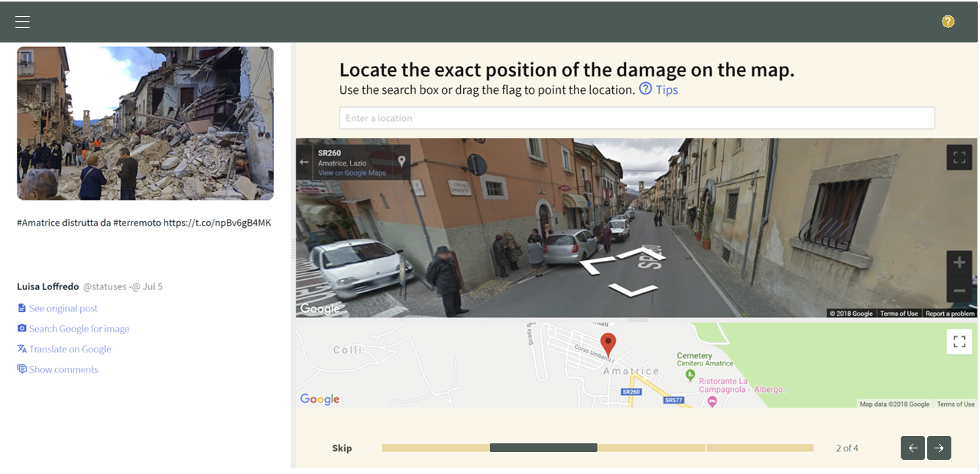
03 Social Media Data Extraction Algorithm
Data Extraction Workflow:
Web Crawlers use APIs (ex: Twitter API) .
Crawlers Search For Specific Keywords (ex: flood, earthquake) prioritizing visual content.
Extract Image Meta Data and Leverage Geo-Location tools (ex: OpenStreetMap) to Locate Incident.
Anti Min-information Measures:
Leverage Computer Vision tools (ex: Google Vision API, OpenCV) to Detect AI-Generated Images and Stock Images.
In-App Volunteer Crowdsourcing Validation. Evaluate Image Trust-Worthiness, Relevance, and Location.
Notes:
As we’ve discussed, the most important aspect of crowdsourcing is actually obtaining data from volunteers to then make something of that data. We’ve discussed how we may encourage these volunteers to act with points and certifications. However, we still believe that isn’t enough.
One of our biggest contributions to crowdsourcing is our Social Media Data Extraction Algorithm. The idea goes like this, use leverage web crawler technology that monitor social media websites such as Twitter through an API, scanning for crisis keywords such as Disaster, Flood, Earthquake, etc. While prioritizing social media posts with actual visual content such as images and videos.
We then Extract the MetaData from these posts and use Geo-Location tools such as OpenStreeMap to locate the incident.
Considering that the data is extracted from social media and not directly uploaded from volunteers through the app, people could upload fake, AI-generated, or stock images. To combat this, we add an extra layer of security leveraging computer vision technology. We use tools such as the Google Vision API and OpenCV to break these images down into pixels and Detect if these images are AI-generated or are stock images.
Now, unfortunately, technology is not yet so reliable that we’d allow an algorithm to fully determine that there is a disaster and signal an alarm. After it computes a high-enough confidence score of the data it collects, this algorithm will then ask app users next to that location to verify this data based on some images that it has extracted. Additionally, since the algorithm is likely to get the position off by at least a few meters, volunteers have the option to move around a pin on a map to pinpoint the location better.

Slide 8

03 UTILIZING CROWDSOURCED DATA: ALERTS
Real-Time Hazard Alerts:
Alerting App-Users Within A specific Range of The Reports.
Visuals Clearly Showing Reported Roads and Areas.
Urgency Scale:
⚠️ Caution: For a Suspected Disaster.
🚨 Critical: For a Confirmed Disaster.
Forwarding To Authorities:
Validated Hazards with a High Confidence Score May be Forwarded to Authorities (Location, Type, Score).
Leads to Swifter Response Time.
Notes:
Now that we’ve shown you how we mainly collect our data, we’ll now show you how we actually utilize that data for disaster management.
Now whenever a report reaches a high-enough confidence level, app users within a specific range of that report will be alerted. Visuals such as images will clearly be shown to these nearby users as they may recognize the area and stay far from it. Additionally, a map should pinpoint the location to them.
For a suspected disaster with a high-enough confidence score, nearby users receive a caution. However, for a confirmed or very-highly-likely disaster, a stronger Critical Alert is given. Signaling a serious problem.
Additionally, with a high-enough confidence score, these alerts are forwarded to higher-authorities, providing the location, type, and likely-hood of the disaster, while showcasing raw data such as images so that authorities may also make their own judgement.

Slide 9
03 SHORTEST PATH ESCAPE ROUTE ALGORITHM
Risk-Weighted Modified Dijkstra’s Algorithm:
Assigning Weights to Distance and Hazard Risk Score (ex: 60% Distance, 40% Score).
Dynamic Rerouting:
Real-time updates when:
New hazards are crowd-validated.
User location changes (GPS drift or alternate path taken).
Visual Guidance System
🟢 Green (Primary Path):
"Direct safest route" – Algorithm’s top recommendation.
Thick highlighted line with animated arrows pointing
direction.
🔴 Red (DANGER Zones):
"Confirmed danger – avoid at all costs" – Blockades, fires, floods.
🔵 Blue (Safe Alternatives):
"Verified safe roads" – Not shortest but hazard-free.
🟠 Orange (Unverified/High-Risk):
"Potential hazard – proceed with caution"
Notes:
Now, in the case of a full-blown disaster, we wouldn’t want our app to fully rely on authorities when it comes to saving the lives of the people. As that alone is not enough in larger disasters, such as in the LA fires. Emergency services, can only help so many people at a time. Sometimes, help cannot get there, and in such cases, we would not want to leave the people empty handed, having no idea what to do next.
The Shortest Path Escape Route Algorithm may just be our largest contribution to crowdsourcing. In the case of a disaster, users will be shown a full map of the area around them. Roads where disasters have been confirmed, such as fires or blockages, or floods, will be blocked and marked with red lines. Roads and Areas with suspected dangers will be marked with orange lines, roads that are verified to be safe will be marked with blue lines.
Most importantly, using these blue safe lines, the algorithm will compute the shortest possible safe path that could get you out of the disaster, and highlight that entire path in green. This path is our attempt at getting the people to safety as fast as possible whenever emergency cannot be contacted. This will provide the user with some safety and ease of mind as a person would typically be too panicked in the event of a disaster to think clearly.
Keep in mind that this path and map keep getting dynamically updated as new hazards are validated or if the user steers off the path accidentally, then a new route will be dynamically re-computed.

Slide 10
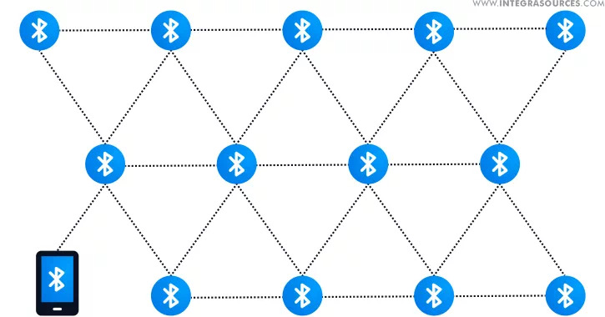
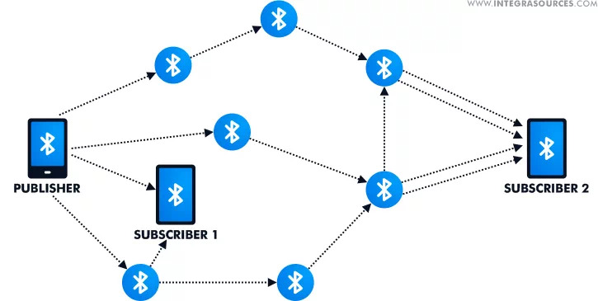
03 OFFLINE/WIFI-LESS APP UTILIZATION:
Pre-Downloaded Cached Evacuation Maps:
Users cache evacuation maps (roads, shelters) when online. These Maps are Continuously Updated While Online.
These Cached Maps can then be accessed offline with a note showing last update time. Example: (last updated 3 mins ago).
Auto-Sync When Online
Uploads offline reports when connection resumes.
Cached Maps are Updated when connection resumes.
Prioritizes high-confidence hazards for sync.
Bluetooth/Wi-Fi Direct Mesh Networking
Peer-to-Peer Hazard Alerts:
Phones share encrypted hazard reports (e.g., "Main St blocked").
Data hops device-to-device until reaching an internet node.
Effective Range & Crowd Density
Bluetooth Classic: ~10-30m (but drains battery).
BLE (Bluetooth Low Energy): ~10-20m (optimized for battery).
Wi-Fi Direct: ~200m (faster, but less common in crowds. Uses slightly more battery than BLE).
Notes:
During our meeting with the doctor, he asked us a very crucial and important question. What would happen if there were simply no internet. How would the app work? Since the internet is very likely to malfunction during a disaster. We suggested that future technologies such as StarLink would completely eliminate this problem. However, we also wanted to find a more ‘present’ way to combat this issue.
One thing we’ve though about is Pre-Downloading these maps into the cache. You see, inside every device there’s a small memory component called the ‘Cache’ which temporarily stores data in blocks. Whenever, you’re still online, every so often the most recently updated Escape Route Map will be saved within your cache. These cached maps can then be accessed offline with a note showing last update time (ex: last updated 3 minutes ago).
While offline, you will also be able to upload reports and evaluate previous reports from other users. The second you become online again, even if for a few seconds. Every offline report will be immediately uploaded, and the most recently updated version of the Escape Route Map is immediately updated to your cache. So, you could access it even while offline.
This second approach is still relatively new and requires many many more optimizations before it is ever put into use. Especially in the aspect of security and power-consumption. The idea is called ‘mesh networking’ and it is a way to share data across long distances with absolutely no internet connection, relying on Bluetooth and WIFI-Direct technologies. How it works is, as we’ve said, users can still upload reports will offline and evaluate previous reports, now instead of waiting for an internet connection, this new acquired data will actually hop from one device to another, until it reaches a device or location that does have internet. For example, this user publishes an offline report, the app then searches any nearby users with activated Bluetooth, and sends them that report, these users evaluate the report, and from their position, the app searches again for the nearest devices, forwarding that report to them as well. This process is repeated again and again and has the potential to cover very large grounds as long as enough devices are nearby. The second that this offline data reaches a device or location that does have internet connection ,such as these two subscribers over here, then these two devices can forward all of that accumulated offline data to our servers, where it will be evaluated and a new escape route map will be created. That map can then be viewed by these devices with internet, which can then share the map to offline devices using mesh networking again.

Slide 11
04 REFERENCES
• Chaves, R., Schneider, D., Correia, A., Borges, M. R. S., & Motta, C. L. R. (2019). Crowdsourcing as a Tool for Urban Emergency Management: Lessons from the Literature and Typology. Sensors, 19(23), 5235. https://doi.org/10.3390/s19235235
• Poblet, M., García-Cuesta, E., & Casanovas, P. (2019). Crowdsourcing Tools for Disaster Management: A Review of Platforms and Methods. International Journal of Disaster Risk Reduction, 34, 1-12.
• Schimak, G., Havlik, D., & Pielorz, J. (2015). Crowdsourcing in Crisis and Disaster Management – Challenges and Considerations. 11th International Symposium on Environmental Software Systems (ISESS), 56-70. • Shankar, A. R., Fernandez-Marquez, J. L., Pernici, B., Scalia, G., Mondardini, M. R., & Serugendo, G. (2019).
CROWD4EMS: A Crowdsourcing Platform for Gathering and Geolocating Social Media Content in Disaster Response. The International Archives of the Photogrammetry, Remote Sensing and Spatial Information Sciences, XLI-3/W8, 331 340.
• Poblet, M., García-Cuesta, E., & Casanovas, P. (2017). Crowdsourcing roles, methods and tools for data-intensive disaster management. Information Systems Frontiers, 20(6), 1363–1379. https://doi.org/10.1007/s10796-017-9734-6
• Liu, S. B. (2014) Crisis Crowdsourcing Framework: Designing Strategic Configurations of Crowdsourcing for the Emergency Management Domain. Computer Supported Cooperative Work (CSCW), 23(4-6), 389–443. https://doi.org/10.1007/s10606-014-9204 3

Slide 12
THANK YOU FOR LISTENING

